Slide 1
Thick Client Pentest Methodology
PS C:\> whoami Aman Sinha
Notes:
Thick client applications, an overview of them, and my approach to testing thick client applications. We will start from the beginning, covering topics such as — an introduction to the Thick client app, Tiers of Thick client applications, we’ll see some useful tools, common vulnerabilities found in these applications, and how to test for them in a systematic manner.

Slide 2

Introduction
According to Wikipedia, a fat client/heavy client/rich client/thick client is a computer (client) in client–server architecture or networks that typically provides rich functionality independent of the central server”.
Thick client applications can be developed using various programming languages such as:
.Net
Java
C/C++
Microsoft Silverlight
Example – Skype, Teams, Outlook etc.
Notes:
- Thick client applications are generally desktop applications that contain nearly all components required for independently operating and executing software applications.
- A Thick Client application is basically an application that runs on the User’s host machine/system and communicates with the backend server or database server.
- So the client application handles most of the business logic like — validations, view components, and temporary data.
Thick client applications can be developed using various programming languages such as:
.Net
Java
C/C++
Microsoft Silverlight
Java applets
Examples of some thick clients-
Spotify
Firefox
Burp Suite
Notepad++
Greenshot, and many others.

Slide 3
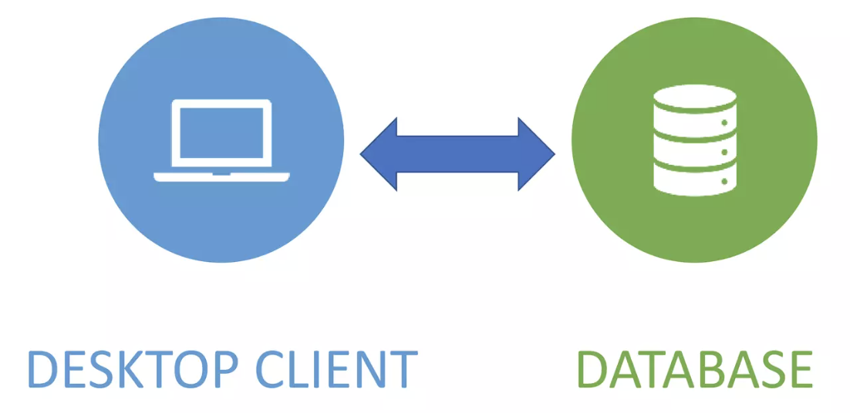
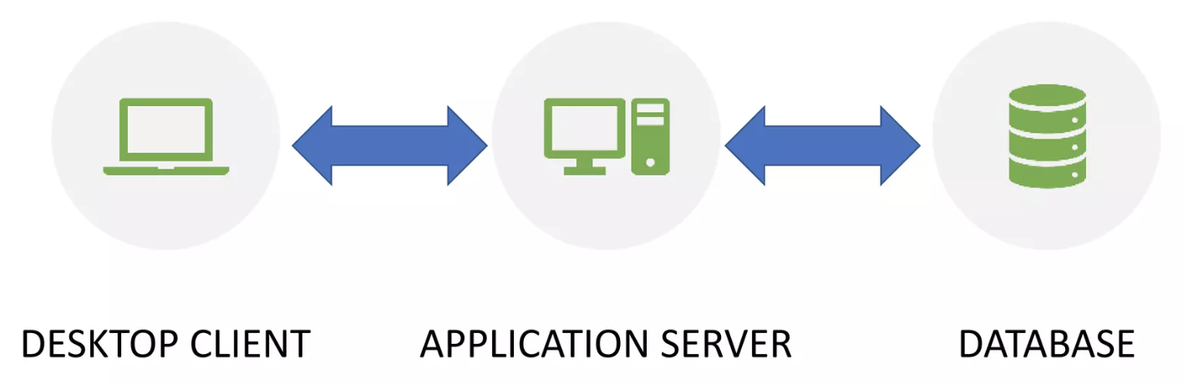
Architectures of Thick Client applications
2 - Tier architecture: The two-tier is based on Client-Server architecture. The two-tier architecture is like a client-server application. Direct communication takes place between client and server. There is no intermediate between client and server.
3 - Tier architecture: Three-tier architecture is a well-established software application architecture that organizes applications into three logical and physical computing tiers: the presentation tier, or user interface; the application tier, where data is processed; and the data tier, where the data associated with the application is stored and managed.
Notes:
Two-Tier architecture -
In two-tier architecture, the thick client application implements a “Client-to-Server” communication. The application is installed on the client’s computer and, in order to work, will need to communicate with a database server. For example, imagine an HR application installed on the client’s computer and, to retrieve the employees’ information, communicates directly with the HR database server.
· Three-Tier architecture -
In the three-tier architecture, the client communicates with an application server, which in turn talks to the database in a manner similar to a regular web application. The most common communication method in these applications may be carried out using HTTP/HTTPS. Three-tier architecture has a security advantage over two-tier architecture because it prevents the end-user from communicating directly with the database server.
Now lets understand this: If a application is directly communicating with the database then what can go wrong: 1. He need to hardcode the database credentials

Slide 4
Why its important for GS
High number of thick client application
Legacy application with old architecture
Protection of financial transactions
Application with sensitive operations like:
Creation of standing instructions
Settling payment
Notes:
There are multiple reasons why thick client pentesting is required
=> High Number of Thick Client Application
=> Legacy application with old architecture - Fixing the finding require change in complete architecture
=> Payment - critical operations like:
Creation of standing instructions
Making payment
Clearing payment
1. Protection of Sensitive Financial Data
Client Portfolios and Investments: Goldman Sachs manages extensive client portfolios, including high-net-worth individuals and institutional investors. Ensuring that thick client applications used for portfolio management are secure helps protect sensitive financial details and investment strategies.
Trading Systems: Proprietary trading systems and algorithms are critical assets. Securing these systems against reverse engineering or unauthorized access is essential to maintain competitive advantage and operational integrity.
6. Protection of Financial Transactions
High-Frequency Trading (HFT): Goldman Sachs engages in HFT, where even minor vulnerabilities can be exploited to gain unfair advantages or cause significant financial loss. Securing these applications is critical.
Transaction Confidentiality and Integrity: Ensuring that all transactions processed through thick client applications are secure helps maintain the confidentiality and integrity of financial operations.

Slide 5
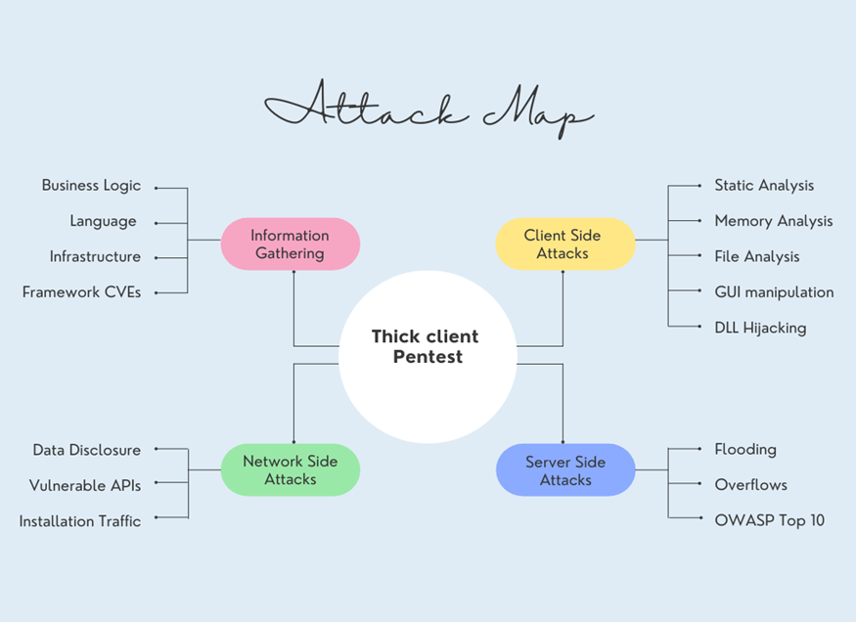
Notes:
There are lots of vulnerabilities in each phases that we can deep dive but with interest of time we will only discuss the broader approach of each phase and also I will give you a reference finding from GS if I have any. So that we can resemble the vulnerability with our existing system.
Lets jump in each phases and see some vulnerability and reference finding from GS. I will not disclos
Talk about Fiddler

Slide 6
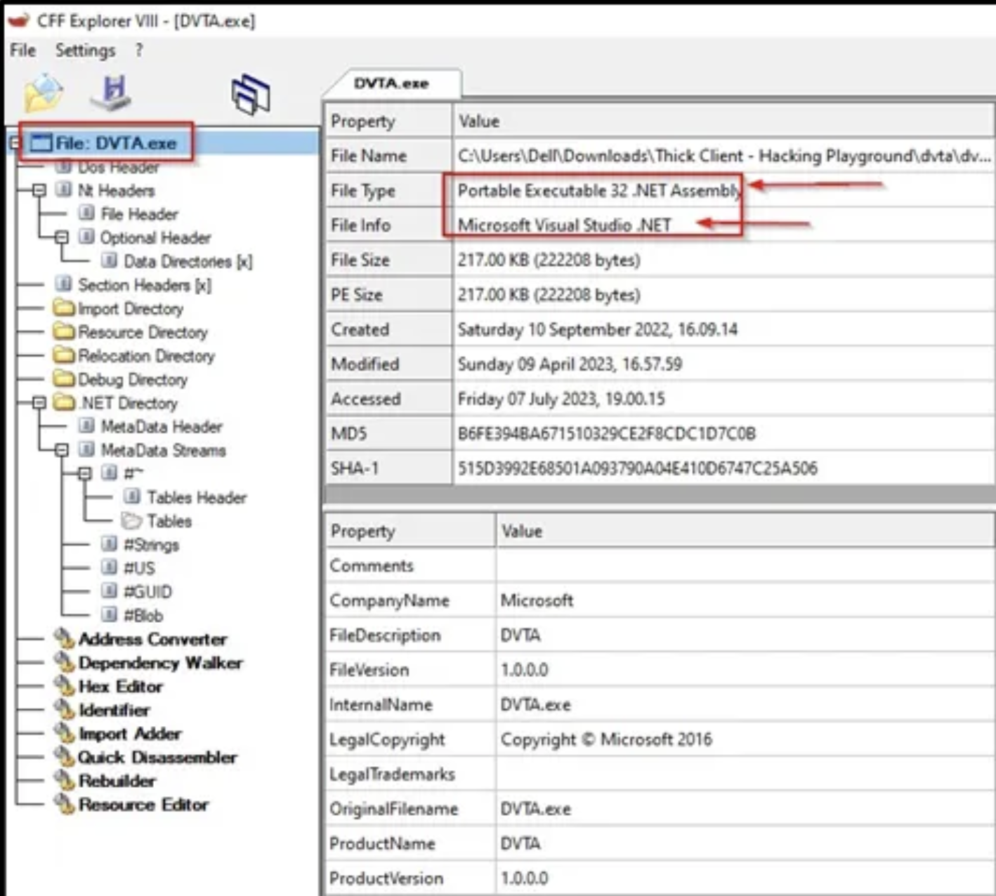



Information Gathering
Network/Traffic Analysis
Server Side Analysis
Network/Traffic Analysis
Client Side Analysis
Server Side Analysis
Application Architecture
Language Frameworks
Application Functionality, Business logic.
Notes:
First, we will start with Information gathering where we will gather information about our target thick client. This phase will be helpful to us to understand our application and select & use the right tools to carry out the Testing.
lets start with 1^{st:}
Knowing the app architecture whether it is a 32-bit or 64-bit will be helpful in creating a “malicious DLL file” for the specific architecture.
This can be easily fetched :
Notepad and looking for PE at the beginning - if the 3rd letter after that is:
an L the platform is 32-bit:
a d the platform is 64-bit:
Language Framework:
Knowing the language will help us to use the right tool to decompile the APP;
For e.x — If it is Built-in “.NET” — dnSpy, dotpeek, etc | or else For “Java” — JD-GUI, etc ).
Knowing application functionality, Business Logic: main thing we will target is

Slide 7
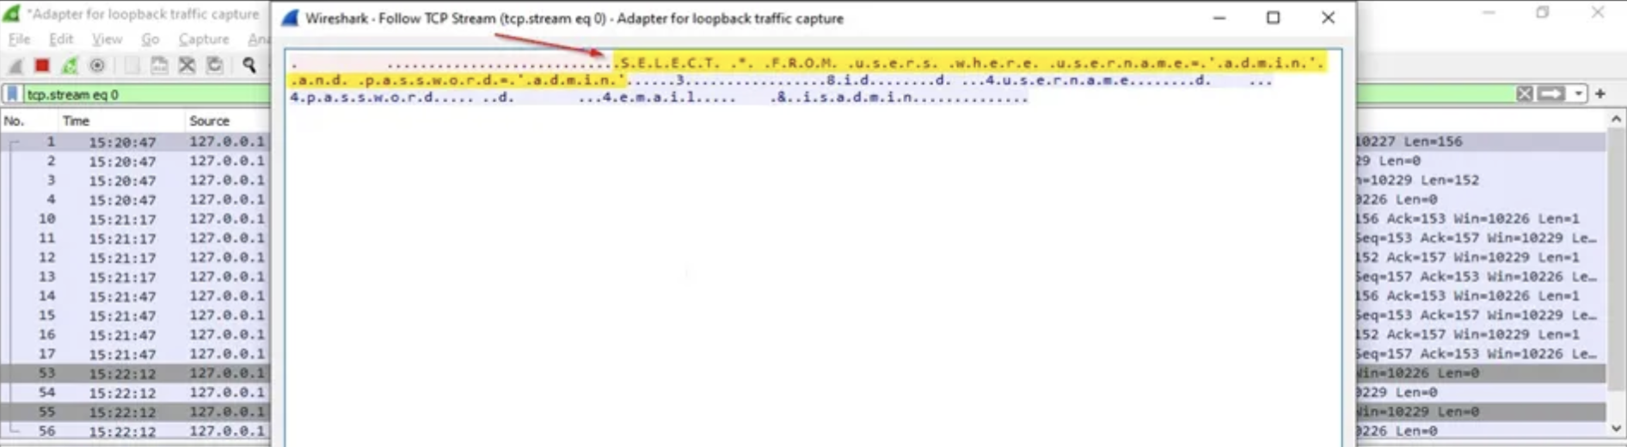

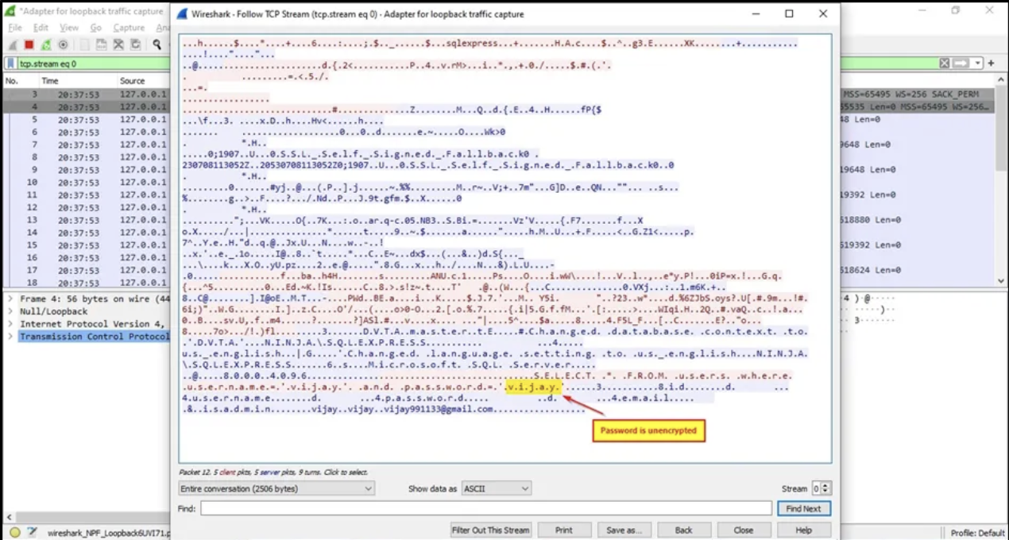

Information Gathering
Server Side Analysis
Network/Traffic Analysis
Client Side Analysis
Server Side Analysis
Network/Traffic Analysis
Identifying the Tier
Application are generally developed in:
2 – Tier Architecture
3 – Tier Architecture
Examining Traffic
Traffic can reveal sensitive data such as:
Clear-text credentials
Any secrets
API endpoints
API Keys
Web Services
Notes:
Identifying the Tier
We’ll now identify the “tier” for our application by analyzing the traffic between the application and the server. For this, we can use tools like — Wireshark, and Echomirage.
Also, Hence there is a high probability that “SQL injection” might be possible and we can test for it while doing “Server Side Analysis” in the later phase.
Examining the traffic: Analyzing the traffic between the application and the server may reveal sensitive data such as Clear-text credentials/secrets/API endpoints, API Keys, (Web Services, REST API), etc in clear text or in an unencrypted format.

Slide 8
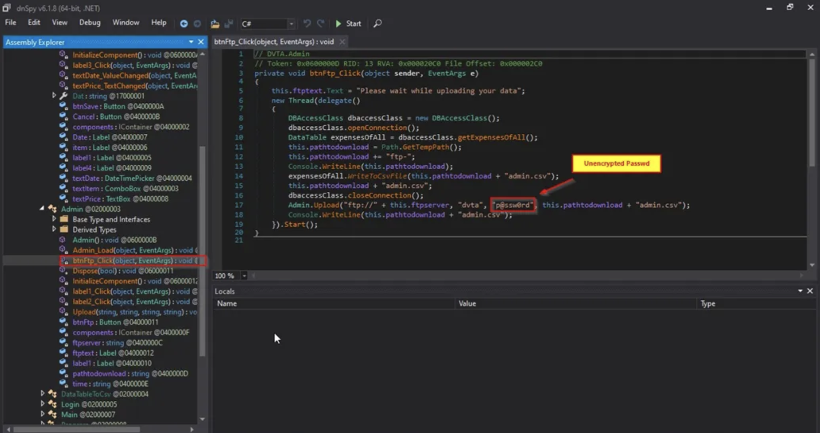

Information Gathering
Network/Traffic Analysis
Server Side Analysis
Network/Traffic Analysis
Client Side Analysis
Server Side Analysis
Binary Analysis
We look for:
Hard-coded credentials
API Keys
API Endpoints
Comments
Hidden functions
Notes:
Binary Analysis -
In Binary Analysis, we’ll manually analyze the binary that is the source code by decompiling it to look for sensitive information, such as:
- Hard-coded credentials
- API Keys
- API Endpoints
- Comments
- Hidden functions
Impact:

Slide 9

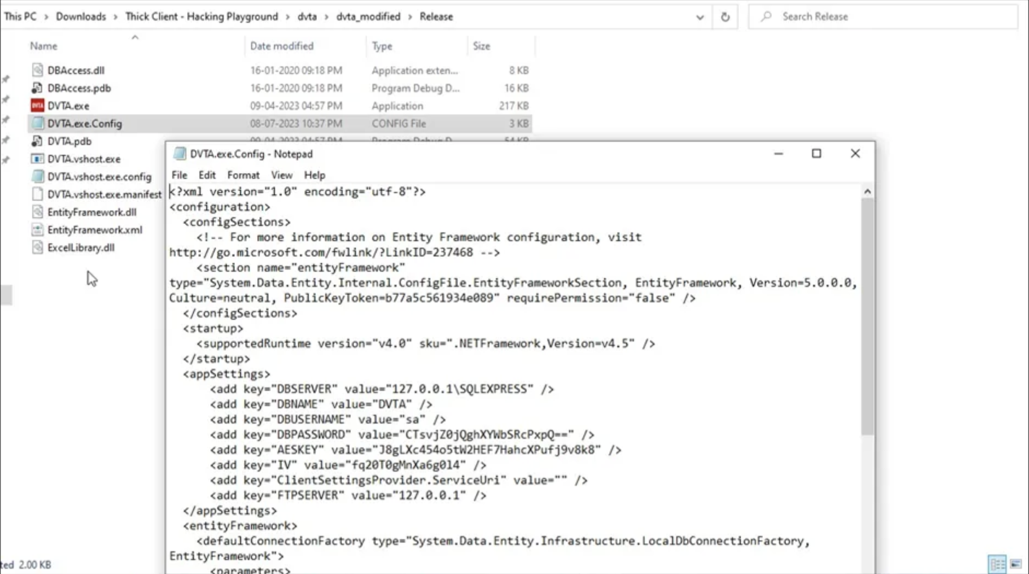
Information Gathering
Network/Traffic Analysis
Server Side Analysis
Network/Traffic Analysis
Client Side Analysis
Server Side Analysis
File Analysis
Sensitive information that we might look for in a thick client pentest includes:
Usernames
Passwords
DB Connection Strings
API keys
Notes:
File Analysis –
Applications usually store information in local files and the registry. Sensitive information that we might look for in a thick client pentest includes:
Usernames
Passwords
DB Connection Strings
API keys
Open and Analyze the log file(s), config file(s), .txt file(s) and other files present in the application folder for any sensitive data.

Slide 10
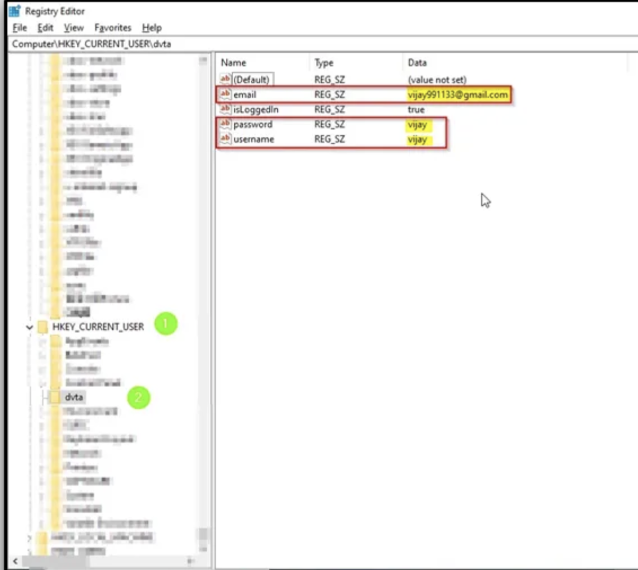

Information Gathering
Network/Traffic Analysis
Server Side Analysis
Network/Traffic Analysis
Client Side Analysis
Server Side Analysis
Registry Monitoring
Some of the common types of sensitive data include:
1. User Credentials
Usernames and Passwords
API Keys and Tokens
2. Configuration Data
Encryption Keys
Database Connection Strings
3. Personal Information
User Profiles
Preferences and Settings
4. Licensing Information
Product Keys
Usage Data
Notes:
Registry Monitoring
Some applications store/writes data like usernames, passwords, or other sensitive information in the Windows registry.

Slide 11
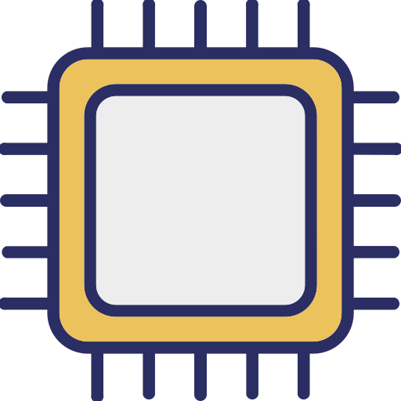
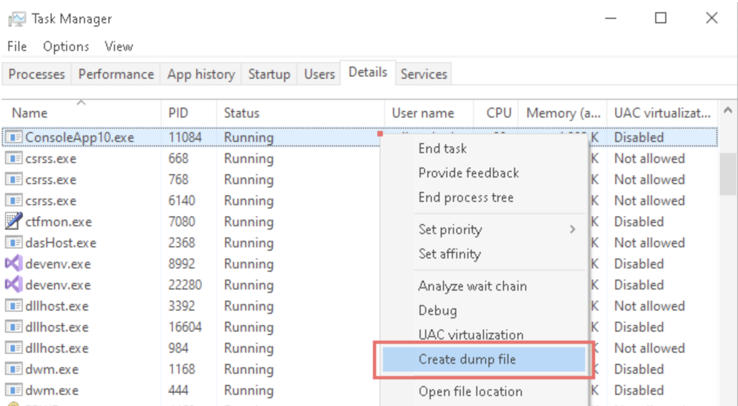
Information Gathering
Network/Traffic Analysis
Server Side Analysis
Network/Traffic Analysis
Client Side Analysis
Server Side Analysis
Memory Analysis
Here are some types of sensitive data that might be found in such a dump file:
1. User Credentials
Usernames and Passwords
Session Tokens
API Keys
2. Database credentials
3. Personal Information
User Data
Sensitive Documents
4. Application Data
In-Process Data
Cache Data
Notes:
Memory Analysis
Thick client applications developed in a two-tier architecture transfer sensitive information into the application’s memory.
This is a design flaw, because every thick client application developed in a two-tier architecture will, by default, disclose sensitive information in the application’s memory, such as Usernames, Passwords, Connection strings, and Hardcoded database credentials.

Slide 12
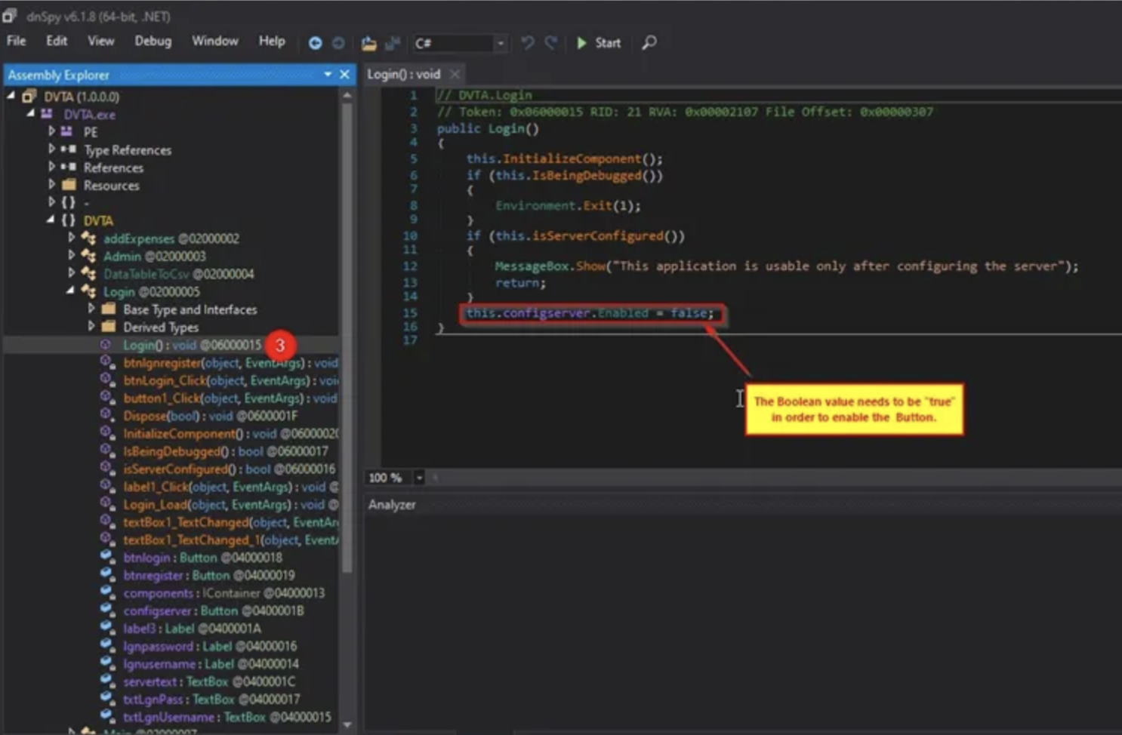


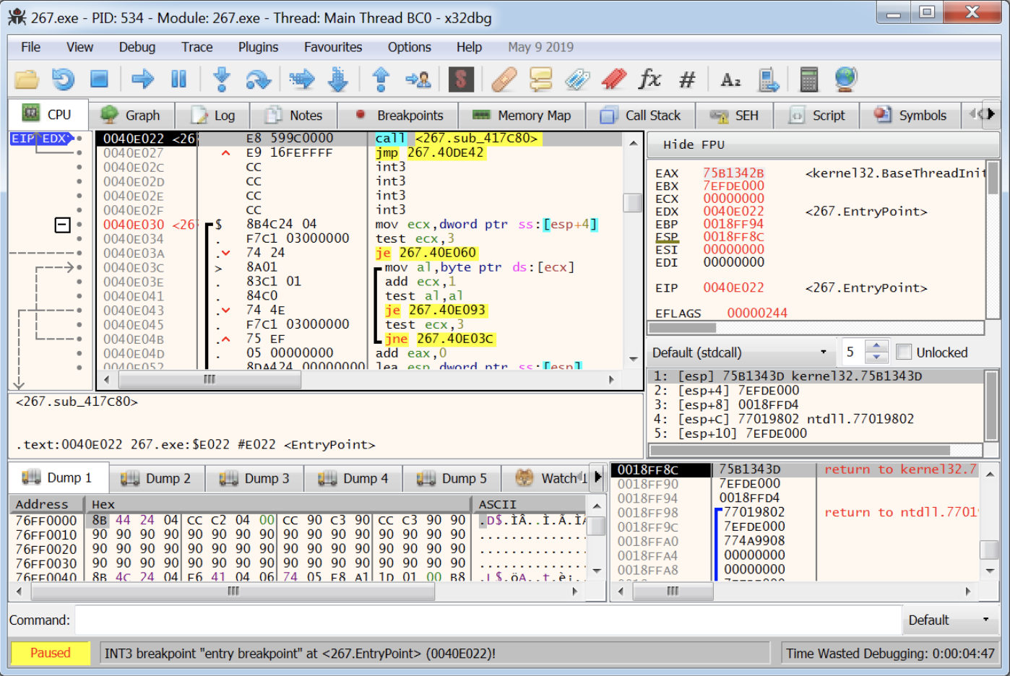
Information Gathering
Network/Traffic Analysis
Client Side Analysis
Server Side Analysis
Network/Traffic Analysis
Server Side Analysis
Reverse Engineering and Modifying the Application:
Code level
Assembly Level
Here are some examples of what attackers can achieve through these methods:
1. Bypassing Authentication and Authorization
2. Extracting Sensitive Information
3. Manipulating Application Logic
4. Injecting Malicious Code
5. Disabling Security Features
Notes:
Reverse Engineering and Modifying the Application – For this I have a example finding ready from my previous pentest. This is going to be interesting.
Here are some examples of what attackers can achieve through these methods:
1. Bypassing Authentication and Authorization
Gain Unauthorized Access: Attackers can modify the application to bypass authentication mechanisms, allowing them to access the application without valid credentials.
Elevate Privileges: Attackers can alter the code to escalate their privileges within the application, gaining access to restricted areas or functions.
2. Extracting Sensitive Information
Hardcoded Secrets: Reverse engineering can reveal hardcoded credentials, API keys, or encryption keys embedded within the application.
Debugging Information: Attackers can access debugging information or logs that contain sensitive data.
3. Manipulating Application Logic
Tampering with Data: Attackers can modify how data is processed or stored, potentially altering financial transactions, calculations, or other critical operations.
Changing Business Logic: Attackers can change the business logic to benefit themselves, such as modifying transaction limits, discounts, or access controls.
4. Injecting Malicious Code
Backdoors and Trojans: Attackers can insert backdoors or Trojan horses into the application, allowing them to gain remote access or control over the system.
Malicious Payloads: Injecting code to execute malicious payloads, such as ransomware, spyware, or other types of malware.
5. Disabling Security Features
Removing Protections: Attackers can disable security features like encryption, input validation, or logging, making the application more vulnerable to further attacks.
Bypassing Anti-debugging Mechanisms: Reverse engineering can help attackers bypass anti-debugging or obfuscation techniques implemented to protect the application.

Slide 13
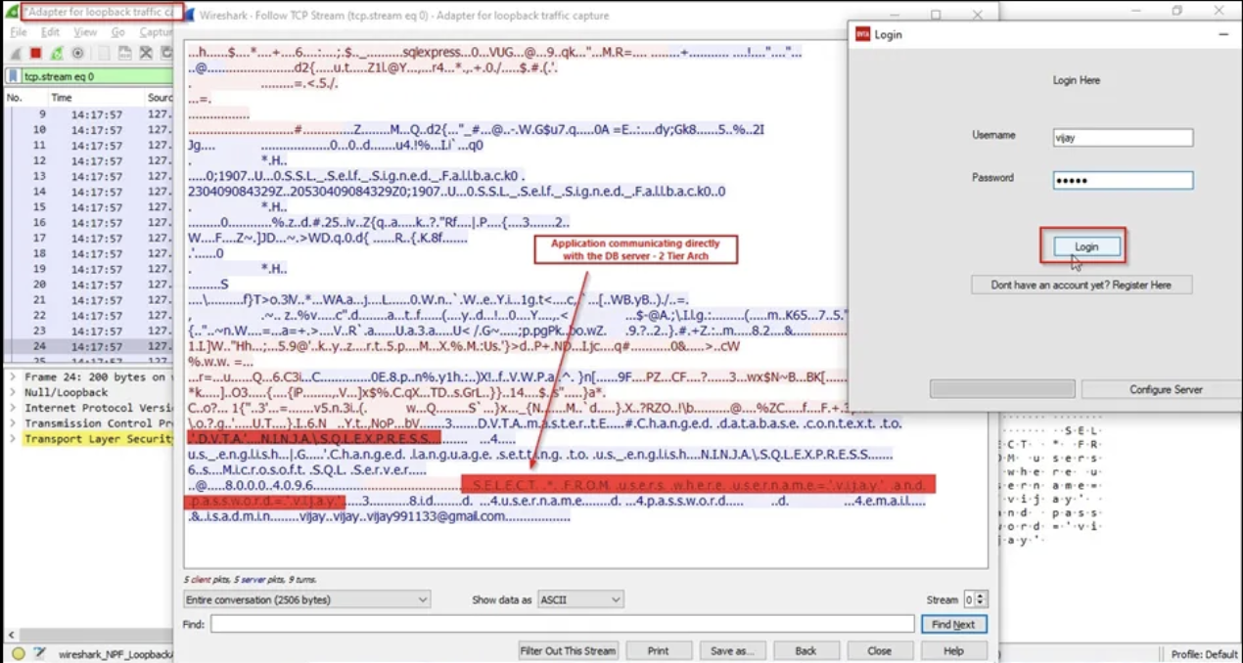

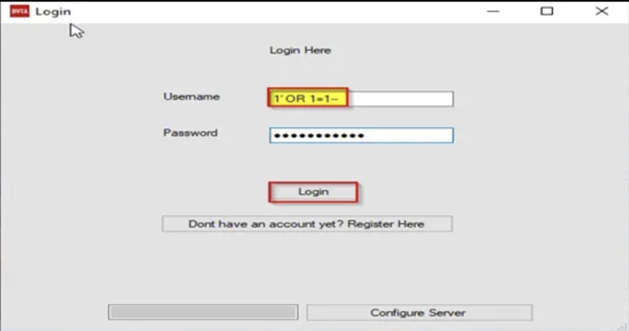
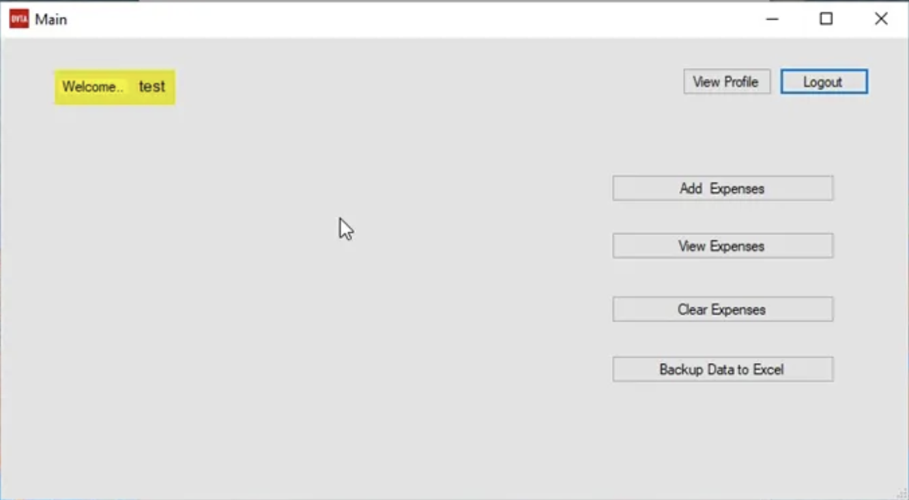
Information Gathering
Network/Traffic Analysis
Client Side Analysis
Server Side Analysis
Network/Traffic Analysis
Server Side Analysis
SQL Injection
Step 1: Analyze the traffic with SQL Commands
Step 2: Inject Payload
Step 3: Successful Exploit
Notes:
The most common vulnerability in thick client applications is SQL Injection

Slide 14
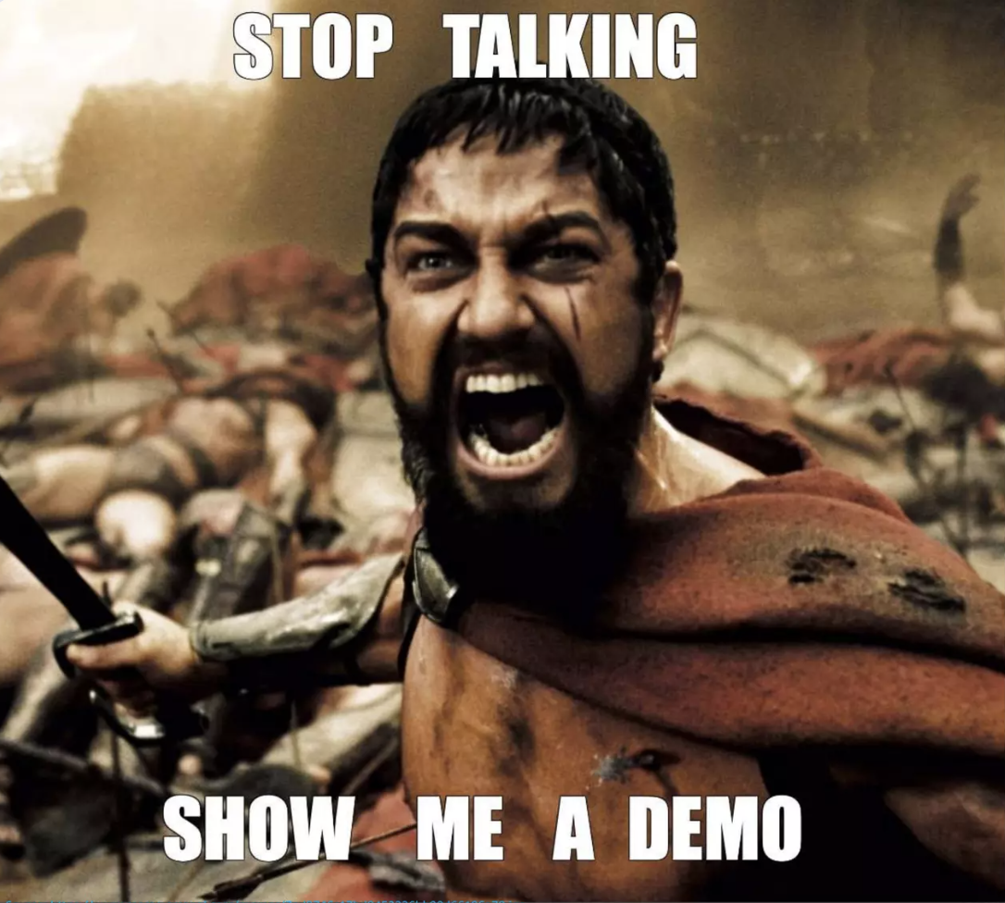
Authentication Bypass Example

Slide 16
References
· https://www.hackingarticles.in/thick-client-pentest-lab-setup-dvta-2/
· https://www.hackingarticles.in/thick-client-pentest-lab-setup-dvta-part-2/
· https://www.cobalt.io/blog/attacking-windows-applications-part-1
· https://www.cobalt.io/blog/attacking-windows-applications-pt.-2
· https://medium.com/techzap/dll-hijacking-part-1-basics-b6dfb8260cf1
· https://atherosec.medium.com/is-your-executable-vulnerable-to-dll-hijacking-8c31cb3f31e1
· https://payatu.com/blog/thick-client-penetration-testing/
Notes:
DVTA - Damn Vulnerable Thick Client Application developed in C# .NET.
DVJA - Damn Vulnerable Thick Client Application developed in JAVA (EE).
DVNA - Damn Vulnerable Thick Client Application developed in NodeJS.

Slide 17
Any Questions ?
Notes:
With interest of time I cannot deep dive in each individual findings. But I would love to if anyone is interested. Please reach out to me.

